Slide 1

Seasonal Agriculture Performance Analysis
Student Name: Aishwarya Bhaurao Kakde
College Name- N. K. Orchid College of Engineering and Technology, Solapur
AICTE STU ID : STU6a69b5a9b36081785312681

Slide 2

PROBLEM STATEMENT
Agricultural performance varies across seasons due to changes in rainfall, temperature, soil conditions, water availability, crop selection, and farming practices. Farmers and decision-makers need to understand these variations to improve crop yield, reduce costs, use resources efficiently, and increase profitability.
This project analyzes agricultural data to identify seasonal patterns, factors affecting yield, resource usage, economic performance, regional differences, and unusual patterns. The goal is to support better agricultural planning and evidence-based decision-making.

Slide 3
Project Description Seasonal Agriculture Performance Analysis is a data analytics project based on 4,000 farm records with 28 attributes. The analysis covers: • Seasonal yield and production performance • Rainfall, temperature, humidity, and soil conditions • Fertilizer, pesticide, irrigation, and water usage • Crop and state-wise performance • Revenue, cost, profit, and profit margin • Water efficiency • Disease and pest risk • Correlations between agricultural factors • Outliers and unusual farm performance The project uses statistical analysis and visualizations such as boxplots, bar charts, heatmaps, and pairplots to identify meaningful patterns.

Slide 4

WHO ARE THE END USERS?
The main end users are:
Farmers – to improve crop selection, resource usage, and profitability.
Agricultural planners – to plan seasonal farming activities.
Government agricultural departments – to support policies and agricultural schemes.
Agricultural consultants – to provide data-driven recommendations.
Researchers and students – to study agricultural trends and relationships.
Agribusiness organizations – to understand production, cost, and market performance.

Slide 5

Technology Used
Python
Data analysis and processing
Pandas - Data cleaning and manipulation
NumPy - Numerical calculations
Matplotlib - Data visualization
Seaborn - Statistical visualizations
Jupyter Notebook
Project development and documentation
CSV Dataset
Source agricultural data
Multivariate analysis

Slide 6
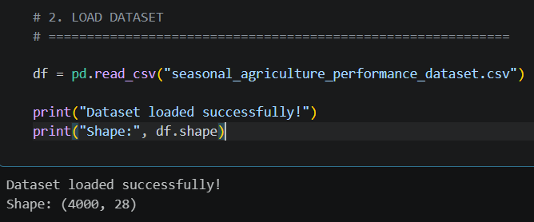
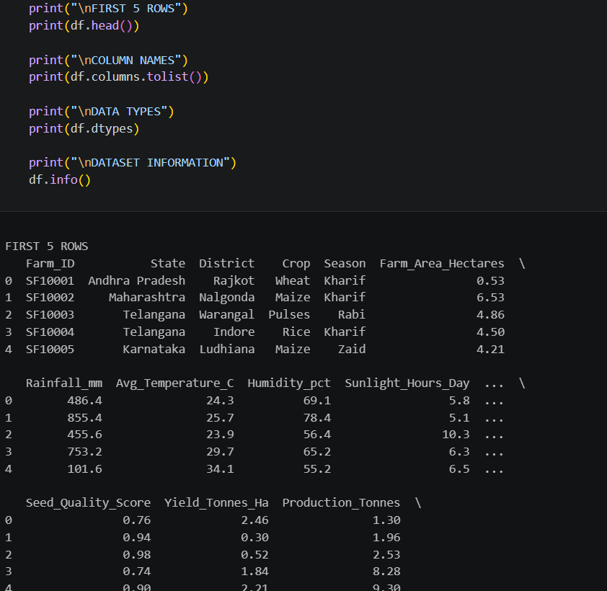
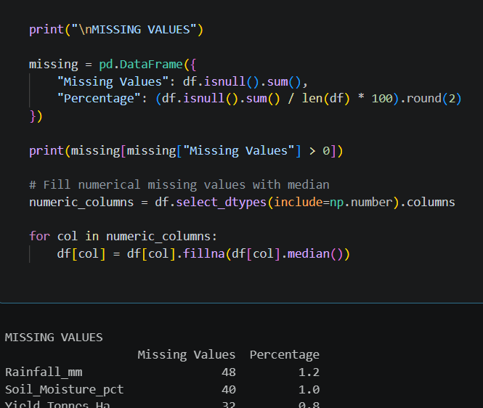
RESULTS

Slide 7
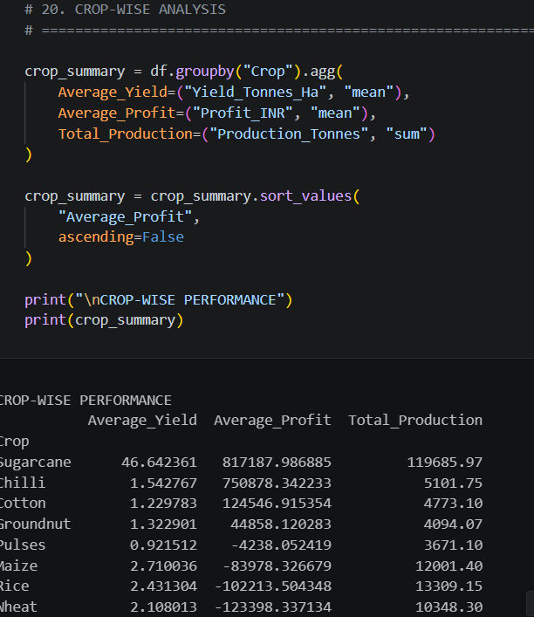
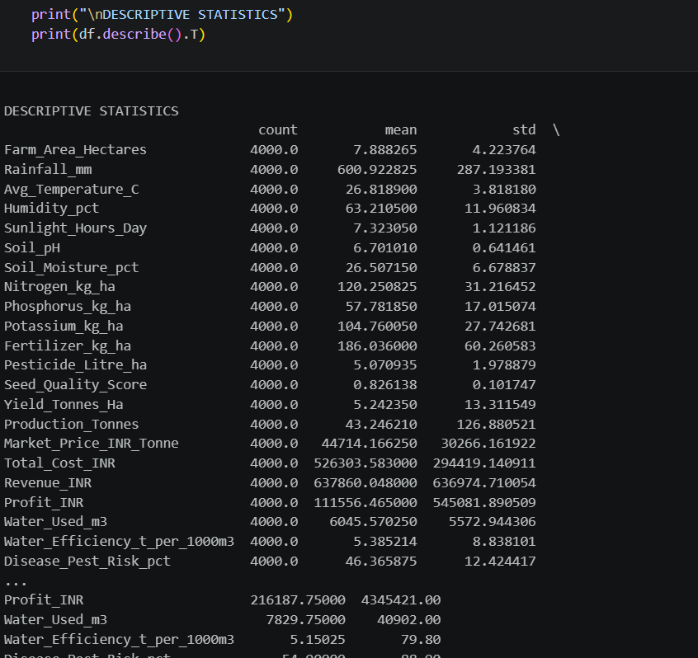
RESULTS

Slide 8
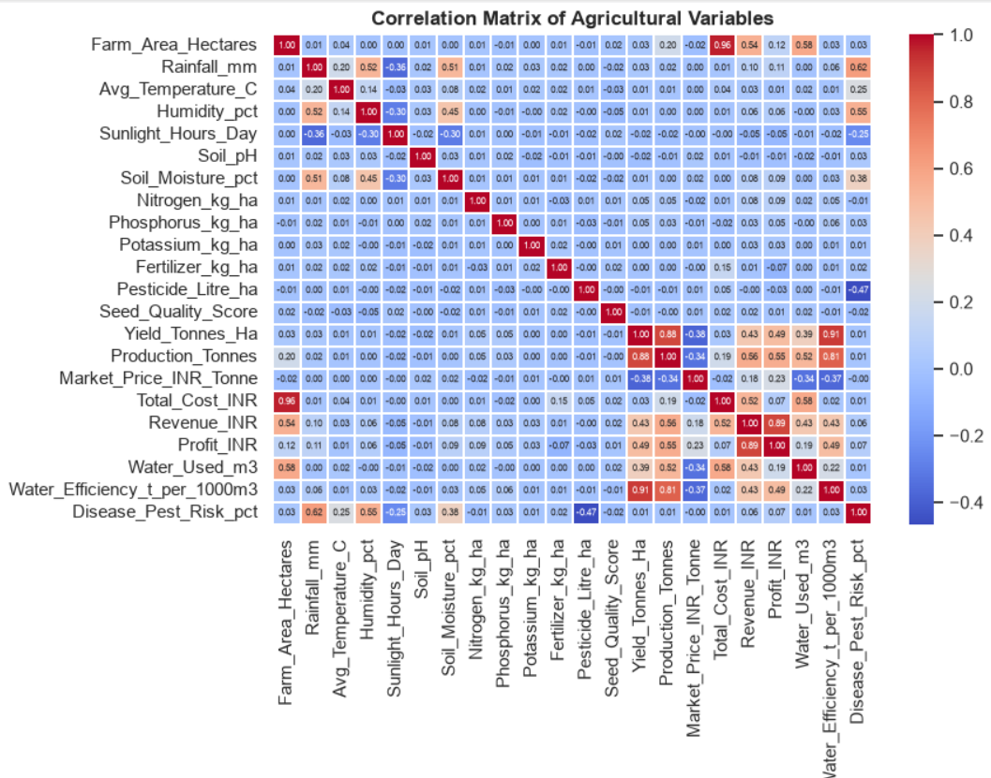
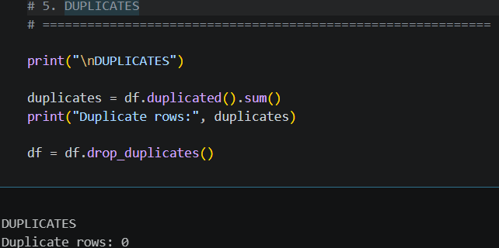
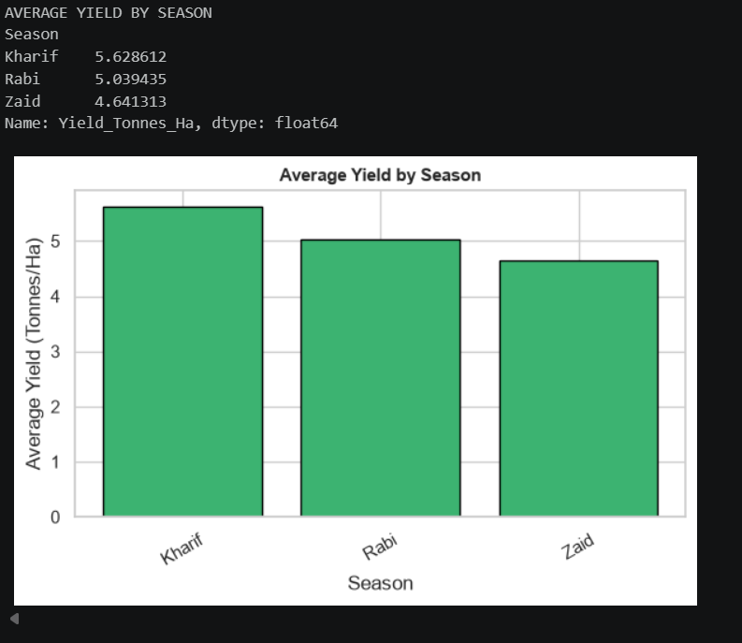
RESULTS

Slide 9
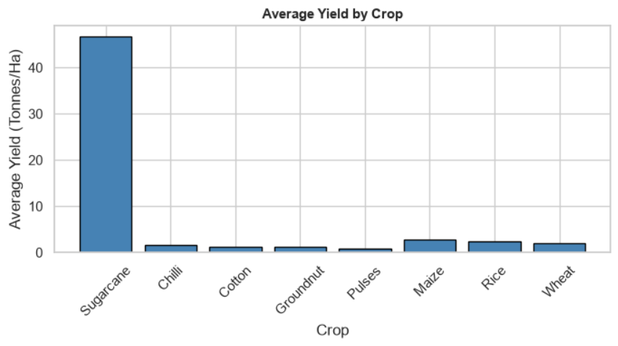
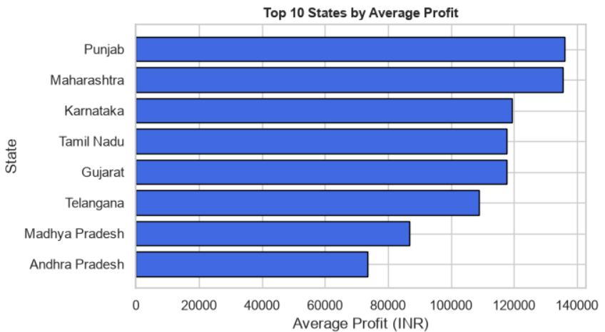
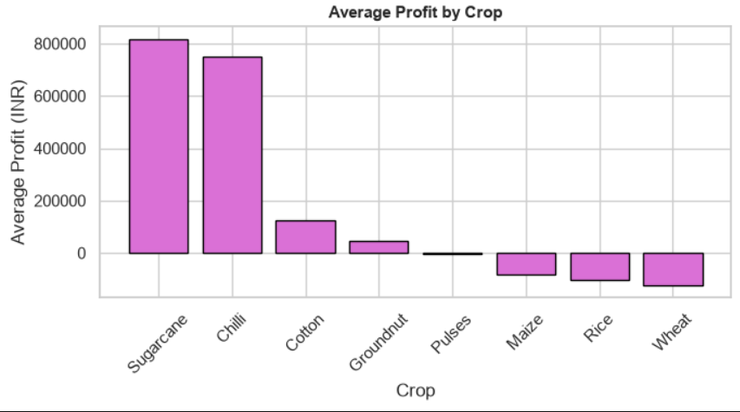
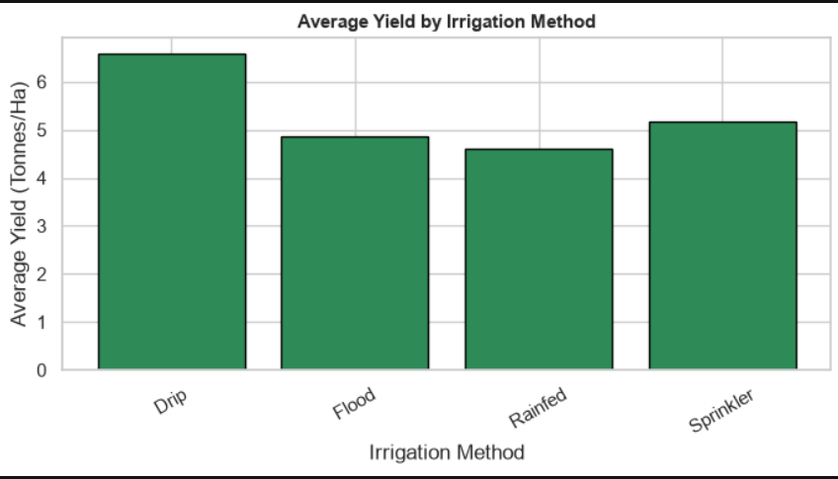
RESULTS

Slide 10
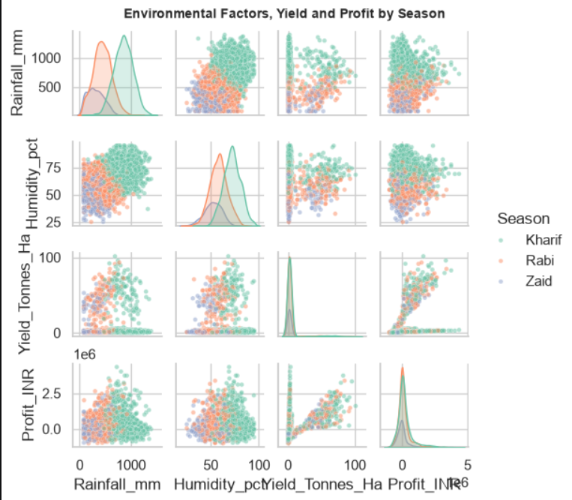
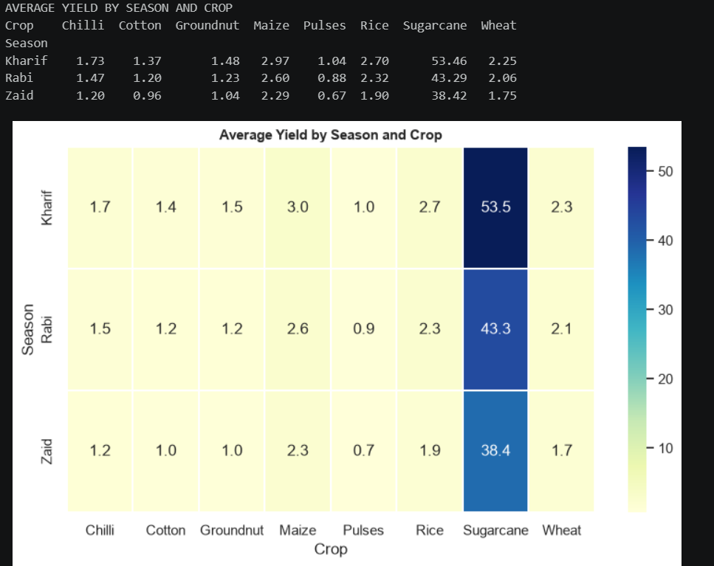
RESULTS

Slide 11
Future scope
The project can be extended by:
Machine Learning – predict crop yield and profit before cultivation.
Weather Forecast Integration – use real-time weather data for seasonal predictions.
Crop Recommendation System – recommend suitable crops based on soil and environmental conditions.
Profit Prediction – estimate expected revenue, cost, and profit.
Disease Prediction – predict disease and pest risks using environmental conditions.
Water Management – develop intelligent irrigation recommendations to reduce water consumption.
Real-Time Dashboard – create an interactive dashboard using Power BI, Tableau, or Streamlit.
Satellite/Remote Sensing Data – incorporate satellite imagery to monitor crop and soil conditions.
Larger Datasets – include more years, regions, and crop varieties for stronger predictions.
AI-Based Decision Support – develop a complete agricultural decision-support system for farmers and planners.

Slide 12
GitHub Link
https://github.com/aishwaryakakde/Seasonal_Agriculture_Performance_Analysis

Slide 13

VOIS Course completion certificate - Course name- Data Visualization

Slide 14
Thank you
.
.

